Slide 1
Artificial Intelligence
AI Integration - ChatGPT, Anthropic – use cases
AI Architecture - Banking, Investment, CRM, Wealth Management – use cases
Architecture review using - Investment Banking use case
AI Architecture – AI Framework
Version 4.0 dd Sep 25, 2025
Alex ILIE

Slide 2
Content
ChatGPT | Slide 3
Anthropic | Slide 4
Anthropic usage | Slide 5
Banking & AI - Architecture | Slide 6
Salesforce CRM & AI - Architecture | Slide 7
Investment Banking Architecture | use case – DRAFT before AI review | Slide 8
Investment Banking Architecture | review with AI – Myst, Anthropic & Claude 3.5 | Slide 9
Investment Banking Architecture | Updated architecture after AI architecture review | Slide 10
Investment Banking Architecture | submit updated architecture for second AI review | Slide 11
Investment Banking Architecture | final AI review results | Slide 12
AI Architecture – AI Components, AI Agents, AI Tiers - Detailed Integration | Slide 13
AI Architecture – AI Framework – support Multiple AI Applications & use cases | Slide 14

Slide 3







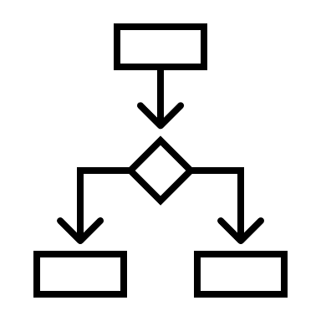

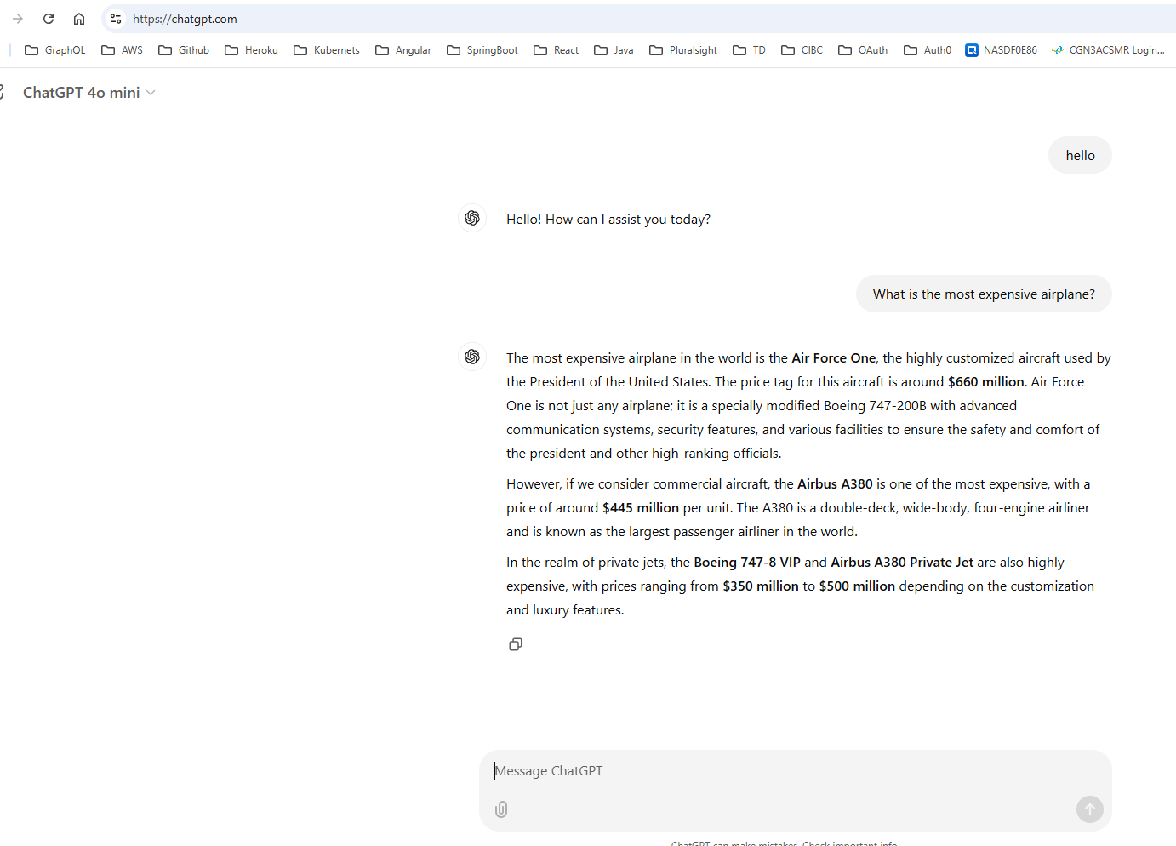
Artificial Intelligence
ChatGPT 4o Open AI LLM - Large Language Model
ChatGPT Web Page
https://chatgpt.com/
API Request JSON
API Tier
Model Tier
AI ChatGPT Prompt question
ChatGPT API
ChatGPT Engine
OpenAI
Model
ChatGPT Prompt answer
ChatGPT
Web User
API Request JSON
Model | LLM – Large Language Models | OpenAI
Features

Slide 4
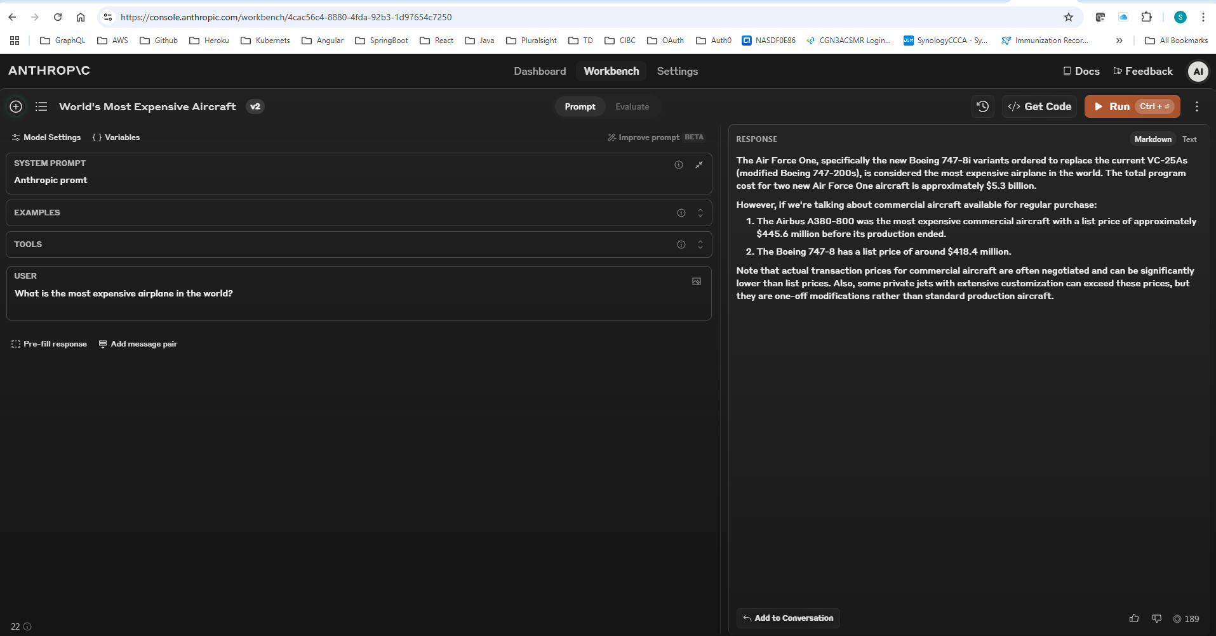
Artificial Intelligence
Anthropic | Claude LLM - Large Language Model
Anthropic Web Page
https://console.anthropic.com/dashboard
API Request JSON
API Tier
Model Tier
AI Prompt question
Anthropic API
Engine
Claude 3.5 Sonnet
Model
Prompt answer
Web User
API Request JSON
Model | LLM – Large Language Models | Claude 3.5 Sonnet
Features

Slide 5
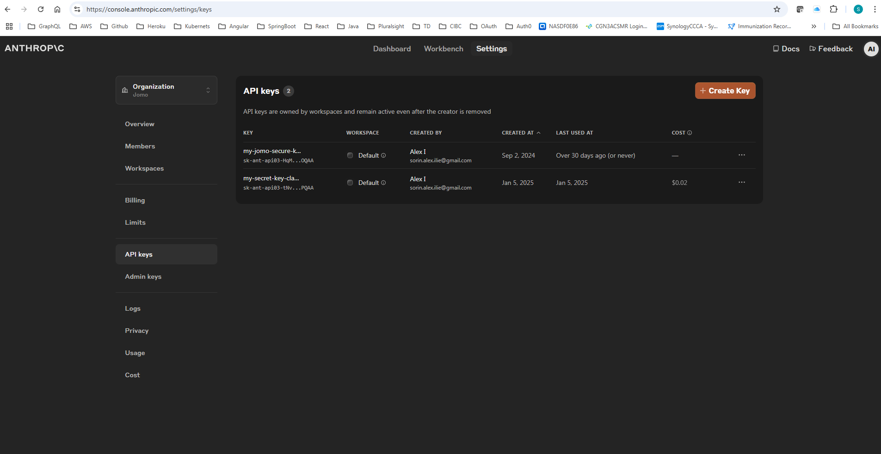
Artificial Intelligence
Anthropic usage with Anthropic.com, VS Code, IntelliJ Anthropic & MYST
Anthropic Console
Web Page https://console.anthropic.com/workbench
Anthropic API Tier
Anthropic Model Tier
API Request JSON
Prompt
Anthropic Engine
Anthropic
Web User
Anthropic API
Claude 3.5 Sonnet
Model
MS Visual Source Code
Anthropic Prompt Plug in
VS Code user
IntelliJ IDE
API Response JSON
Anthropic API Keys
Anthropic Prompt Plug in
IntelliJ Desktop user
MYST App
Anthropic Prompt Plug in
qwen2.5-coder:7b
qwen2.5-coder:3b
MYST Desktop user
Anthropic Prompt usage; Anthropic Console
Web Page https://console.anthropic.com/workbench
Anthropic API Authorization using Anthropic API Keys

Slide 6
Artificial Intelligence
Banking & AI - Architecture
Banking Frontend
SPA - React
FEBE API
Service API
Backend Systems
Book Of Record
Client API
Client API
Client BoR App
Account API
Account API
Account BoR App
Transaction API
Transaction API
Payments BoR App
Transfer API
Transfer API
Transaction Processor BoR App
Accounts
Payments API
Payments API
Transactional Database
Products BoR App
Preference API
Transactions
Transfer
Pay bills
Investments
AI Gateway
Inbound
AI Orchestration tier
AI Agents Tier
AI Workflow
AI Gateway
Outbound
AWS SageMaker
Bank
Customer
AI Banking Prompt/ Chat
Gateway
Controller
RAG Agent
Component
LLM Gateway
User Intent Detection
AI Agent APP 1
AZURE OpenAI
Component
Router
AI Agent APP2
What is my Mortgage interest rate?
What is my Credit card Limit?
What is my Daily Transaction Limit?
What is my last year RESP contribution amount?
What is my Grocery Monthly % ?
What is my current year Mortgage contribution amount?
What is total Enbridge yearly cost ?
What is my current year Phone charges amount?

Slide 7
Artificial Intelligence
SalesForce CRM & AI – Architecture
Banking SPA - React
FEBE API
Service API
Backend Systems
Book Of Record
Accounts
Client API
Client API
Client BoR App
Transactions
Account API
Account BoR App
Account API
Transaction API
Payments BoR App
Transfer
Transaction API
Transfer API
Transaction Processor BoR App
Pay bills
Transfer API
Payments API
Products BoR App
Payments API
Transactional Database
Preference API
SalesForce CRM
AI Gateway
Inbound
AI Orchestration
AI Agents
AI Workflow
AI Gateway
Outbound
CRM user
AWS SageMaker
Gateway
Controller
RAG Agent
Component
AI GUI Application
LLM Gateway
User Intent Detection
AI Agent APP 1
Component
Router
AI Agent APP2
AZURE OpenAI
What is my Mortgage interest rate?
What is my Credit card Limit?
What is my Daily Transaction Limit?
What is my Grocery Monthly % ?
What is total Enbridge yearly cost ?

Slide 8
Artificial Intelligence
AI Architecture | Investment Banking – DRAFT before First AI review
Investment Banking SPA - React
FEBE API
Data Service API
Backend Systems
Book Of Record
Accounts
Client API
Client API
Application
Positions
Account API
Account API
Transaction API
Position Performance
Transaction API
Positions API
Positions API
Performance API
Investment
user
Preference API
Transactional Database
Application
SalesForce CRM
AI Gateway
Inbound
AI Orchestration
AI Agents
AI Workflow
AI Gateway
Outbound
Investment
Advisor
AWS SageMaker
RAG Agent
Gateway
CRM Support
Controller
Component
LLM Gateway
AI GUI Application
User Intent Detection
AI Agent APP 1
Component
Operations
AI Agent APP2
AZURE OpenAI
Router
What is my RRSP Limit contribution?
What is total Market Value of all my accounts holdings?
What is the AI trend and suggestions?

Slide 9
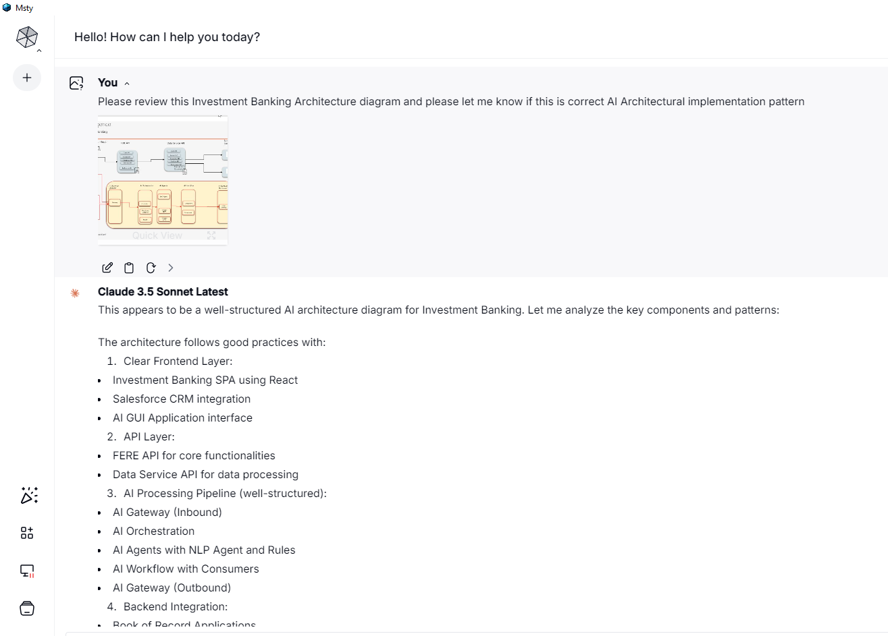
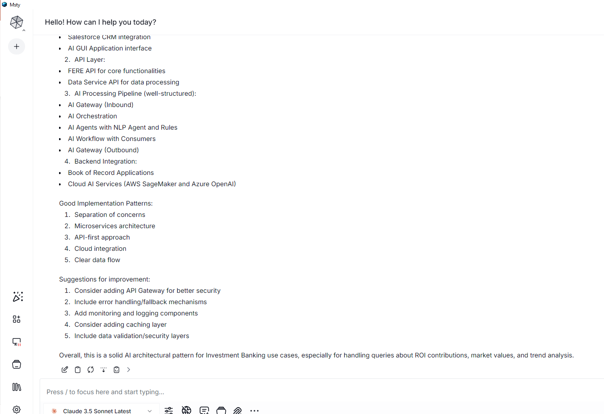
Artificial Intelligence
AI Architecture | Investment Banking – first architecture review with Msty and Anthropic & Claude 3.5 LLM

Slide 10
Artificial Intelligence
AI Architecture | Investment Banking – updated version
Investment Banking SPA - React
FEBE API
Data Service API
Backend Systems - Book Of Record
Client API
Authorize with API Entra Azure AD token
Client API
Authorize with API Entra Azure AD token
Accounts
Account API
Account API
App1 API
Positions
Transaction API
Transaction API
APIGEE
Positions API
APIGEE
Positions API
Position Performance
Performance API
Transactional Database
Preference API
App2 API
Investment
user
Entra AZURE AD
OCP LaaS
OCP Monitoring
OCP REDIS Cache
User Data Entitlements API
User Data Entitlements API
SalesForce CRM
AI Backend Systems
API Gateway
AI Gateway
Inbound
AI Orchestration
AI Agents
AI Workflow
AI Gateway
Outbound
AWS SageMaker
Investment
Advisor
AWS Cloud AI API
AI Model
AI FEBE API
APIGEE
CRM Support
Controller
RAG Agent
AI GUI Application
Authorize with API Entra Azure AD token
Gateway
LLM Gateway
User Intent Detection
AI Agent APP 1
AZURE OpenAI
Operations
Azure Cloud AI API
Open AI Model
Component
Router
AI Agent APP2
Component
SSO User Authorization
Entra AZURE AD
Entra AZURE AD
Entra AZURE AD
OCP LaaS
OCP Monitoring
OCP REDIS Cache
User Data Entitlements API
What is my RRSP Limit contribution?
What is total Market Value of all my accounts holdings?
What is the Investment trend and suggestions for my acocunts?
User Data Entitlements API

Slide 11
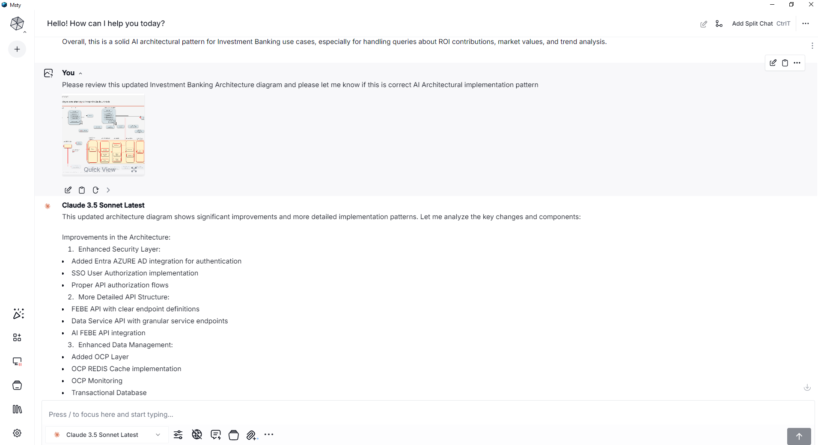
Artificial Intelligence
AI Architecture | Investment Banking – second architecture review with Msty and Anthropic & Claude 3.5 LLM

Slide 12
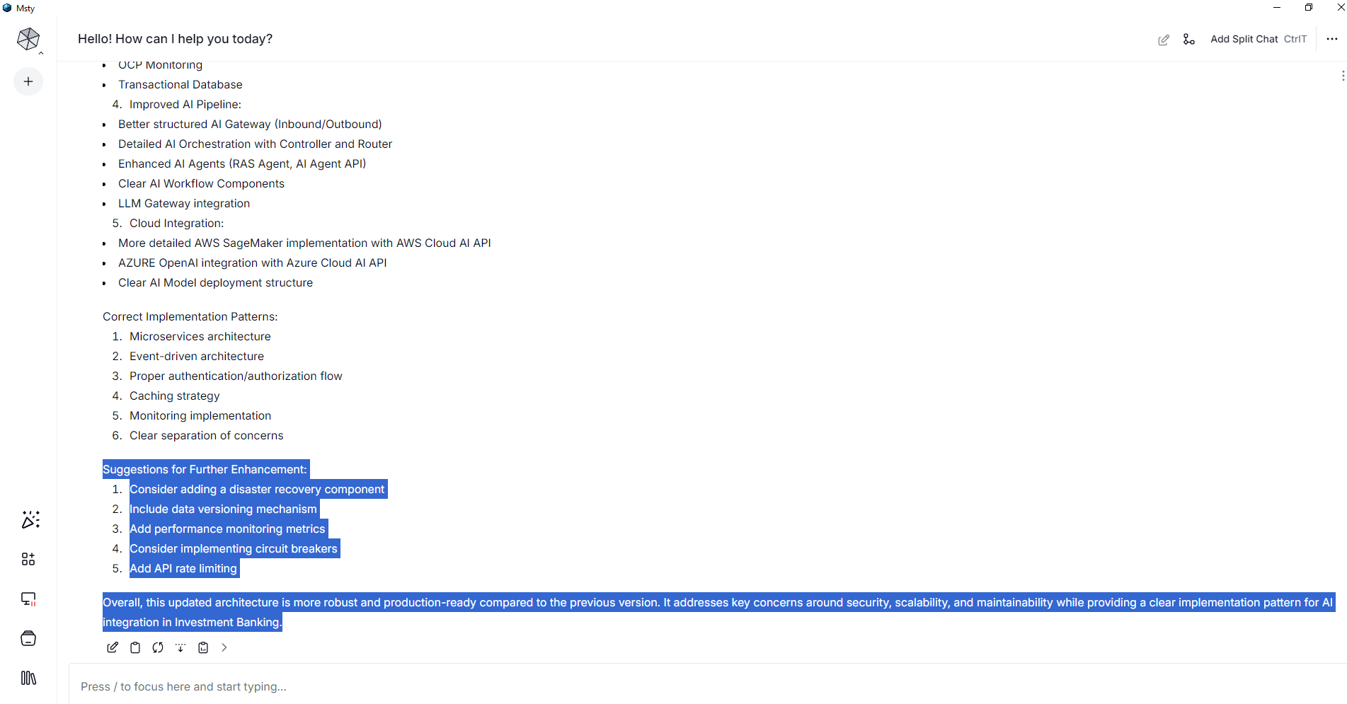
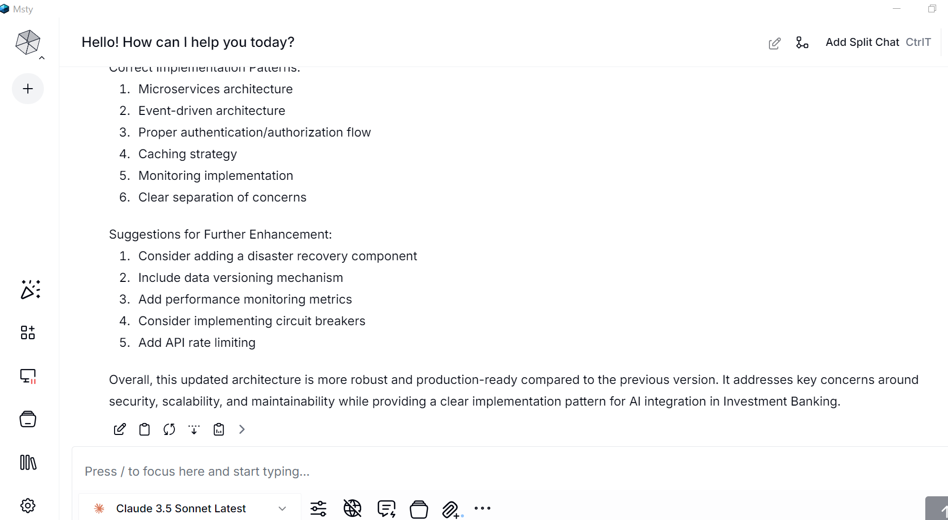
Artificial Intelligence
AI Architecture | Investment Banking – AI response after second architecture
Suggestions for Further Enhancement:
Consider adding a disaster recovery component
Include data versioning mechanism
Add performance monitoring metrics
Consider implementing circuit breakers
Add API rate limiting
Overall, this updated architecture is more robust and production-ready compared to the previous version. It addresses key concerns around security, scalability, and maintainability while providing a clear implementation pattern for AI integration in Investment Banking.

Slide 13


Artificial Intelligence
AI Architecture Framework | Detailed Integration
AI GUI
Front-End
Gen AI Gateway
Inbound
Gen AI Orchestration Tier
AI Agents Tier
AI Workflow Tier
Data Tier
Downstream Apps
SaaS AI Gateway
Outbound
SaaS AI
User Query Intent Detection API
AWS SageMaker
LLM Gateway
AI API
Gateway
AI Orchestration Controller API
Router Service API
Investment Adviser
Documents Upload
Structure DB
Admin
AI Agent API
User Chat Consumer Service API
Admin
Reporting DB
AI SQL Generator Agent API
Operations
AI SQL Retriever Agent API
RAG Doc Consumer Service API
Vector DB
AI Realtime Augmented Generator Agent API
AZURE OpenAI
AI Agent X API
App1 API
Open AI API
AI Agent Y API
AI App 2 Agent API
App 2 Workflow Integration Service API
App 2 API

Slide 14
AI Architecture Top-Down | AI Framework & Multiple AI Applications, AI Agent Tier
Bank Customer
Bank user
Admin
Operations
Users
FrontEnd tier
AI App 1 Front-End
AI App 2 Front-End
Entra Azure AD
APIGEE – API Gateway
AI Application Gateway
AI Application Orchestration 1
AI Application Orchestration 2
AI Orchestration Tier
NLU intent recognition 1
Router 1
NLU intent recognition 2
Router 2
Entra Azure AD
Security Tier
AI Agents Tier
AI Agent
AI RAG Realtime Agent
AI Agent
AI Agent
SQL Retriever Agent
SQL Generator Agent
AI App Agent
AI RAG Batch Agent
App API
App API
Data Service API Tier
APIGEE
AI Application Gateway
Vector DB
Metadata
DB
Application DB
AI SageMaker LLM Model
AI SageMaker Embedding Model
AI SageMaker LLM Model
Data Tier
AI SaaS APIs Tier
App API
App API
App
App
Application Tier BoR
Entra Azure AD
Monitoring
Logging LaaS
REDIS Cache
Data User Data Entitlements
Data Tier BoR

